Slide 1
Women’s Collaborative “Business Leadership” Series
Websites and the Small Business

Slide 2
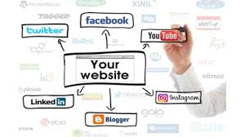
Websites and the Small Business
Website relevance in 2021
“The cost” unmasked
A Planning Checklist for effective execution

Slide 3
A Website is the Foundation of Your Marketing Strategy in Today’s Environment.
Brand Awareness that only you can control
Generate Leads from online search engines
Place to offer Value and capture emails with a Call to Action (CTA)
Reengage with customers on new promotions, tips, highlights
Attract employees, business partners, strategic alliances
Showcase your business, culture, testimonials, messaging
Provide support, FAQs, resources

Slide 4
A Basic Website Can be a Cost-effective and Low-Maintenance Way of Advertising Your Business
There are three basic requirements for starting a website.
Domain Name – $20/year
Web Hosting / Internet Service Provider – $150/year for basic
Someone to Build the Site – $250 to $5000 one-time fee Cost varies based on need for outsourcing support Graphic Designer ~ Web Developer/Coder ~ Web Designer Reality is that WordPress and other website building platforms feature professionally-designed templates and easy-to-use editors.

Slide 5
Step by Step Basics for Planning an Effective Website
Overview of Your Organization
What is the Purpose of the Site
From your business plan – what are you selling, what problem are you solving, who is your customer?
Explain services, bring new clients in, provide information on specific topics, allow clients to request services, etc?
What is Your Timeline
How Much are You Willing to Spend
Do you have the logo, pictures, copy, key words for search engines? How flexible are you for getting this completed?
Your budget will make it easier to recommend an approach to this project and avoid surprises down the road.

Slide 6
Step by Step Basics continued
Who is your Target Market?
What Sets You Apart from Competition?
Describe the age, gender, purchasing power, social class, location, consumer habits, etc. of your ideal customer.
From your marketing research, why will your target market prefer working with you?
What CTA will you include on the site?
List Competitor Websites
Do you want visitors to call you, fill out a form, search for information, sign up for mailing list, purchase something?
What do you like/dislike about their sites? What do you want to do differently or better?

Slide 7
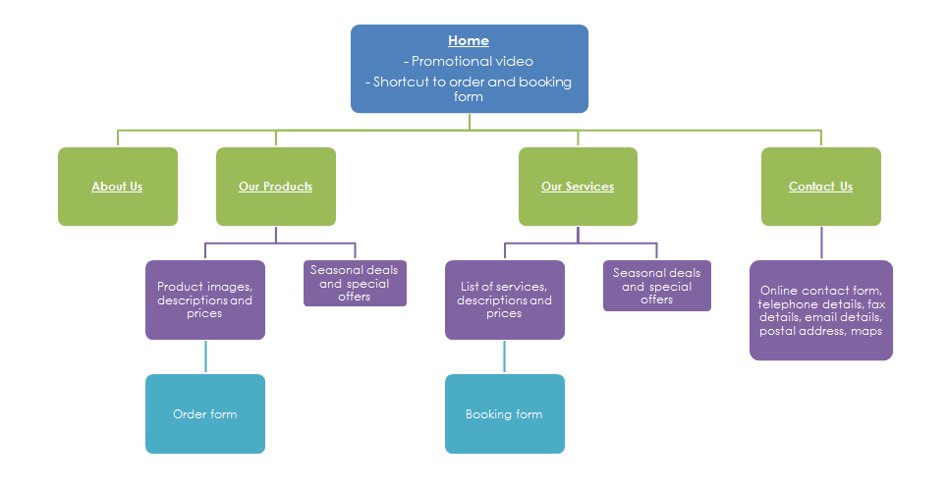
Step by Step Basics continued
What Sections /Pages Will You Need?

Slide 8
Step by Step Basics continued
What is Your Brand Guide
What Other Elements Are Important
Include your logo, tag line, colors, fonts, design elements, etc. What first impression should visitors have?
Search the web for organizational, functional, useful ideas you would like to replicate. What do you like and why?
How Will You Market the Site?
Who will Maintain the Site?
Do you have social media accounts set up? Will you use a mail service account? Will you need printed materials? Loyalty programs?
What sections will be regularly updated? What will need periodic changes for Search Engine Optimization?

Slide 9
Websites and the Small Business
Website relevance in 2021
“The cost” unmasked
A Planning Checklist for effective execution

